Slide 1
Progress of MSC-W activities
(How developments will feed into the ‘new’ GAINS developed for the GP review)
Hilde Fagerli & co-workers at EMEP/MSC-W

Slide 2
Content
EMEP reporting 2021
How latest EMEP/MSC-W developments & work will feed into a revised version of GAINS developed for the GP review
Talks reporting progress of MSC-W activities 20/21:
Condensable organics; follow-up to Gothenburg (NMR) workshop, David Simpson (MSC-W/MET) Monday 15:50
High resolution exposure calculations for Europe, Western Balkans and EECCA countries using EMEP and uEMEP, Bruce Rolstad Denby (MSC-W/MET) Tuesday 17:00
Relative changes in SO_{x}, NO_{x} and NH₃ emissions 2005 - 2030 and their effects on secondary inorganic aerosols and nitrogen deposition, Jan Eiof Jonson (MSC-W/MET, Norway) Wednesday 10:00

Slide 3
EMEP/MSC-W reporting 2021
Assessment of 2019 (using EMEP emissions, but with GNFR_C replaced by a Ref2 (updated) for all countries, except those who (certainly) reported with condensables. SR. Country reports.
Updated modelled trends runs 2000-2019 (no condensables) with
Re-reported EMEP emissions 2000-2019, with new gridding (CEIP)
Latest EMEP model version
Renewed EMEP Trend interface
Replace ‘Model Evaluation Report’ by web interface

Slide 4
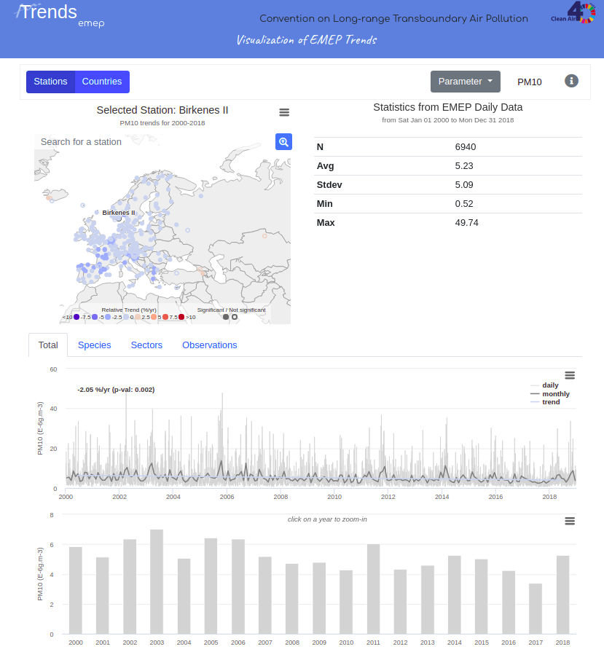
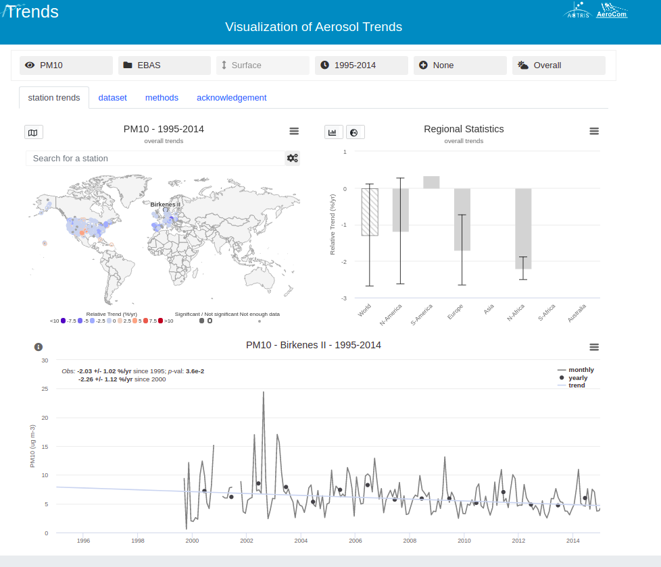
New EMEP Trend Interface
New version:
Better statistics (regional, seasonal) for both obs and mod
Revisit long term observations with CCC
Extend to ‘all’EMEP variables (incl e.g. wet deposition etc)
More features
Keep chemical species, sectors
New version summer 2021

Slide 5
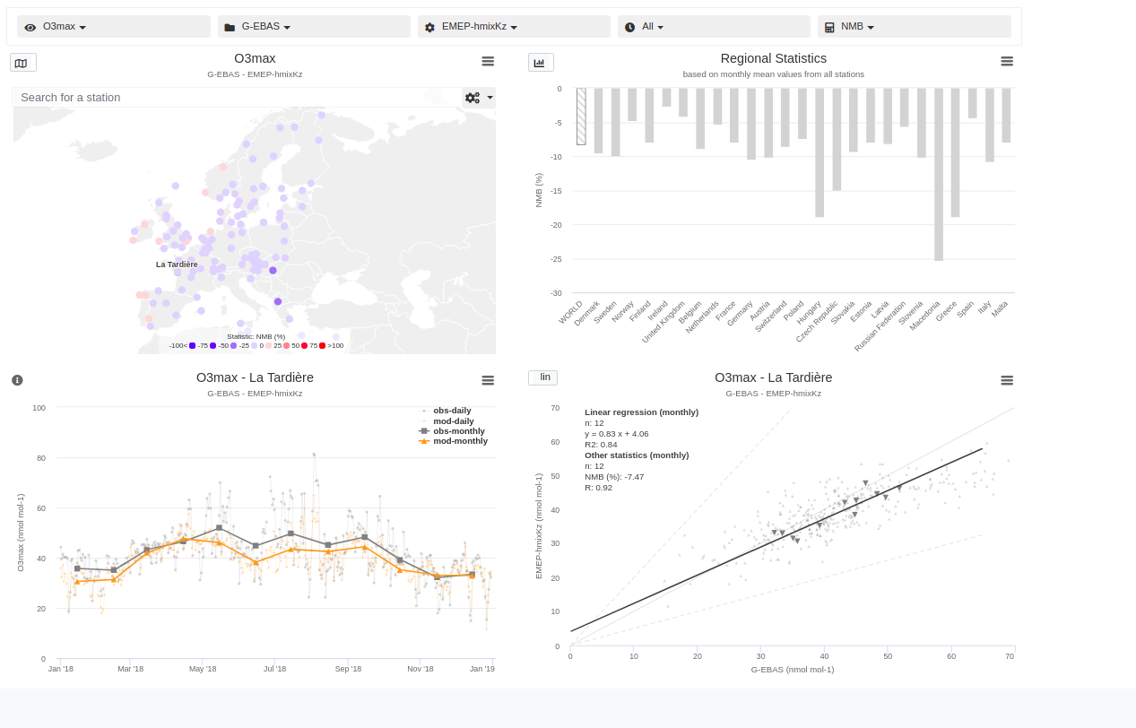
EMEP evaluation report
Step-wise move away from ‘pdf reports’ to web services when that is more valuable for the users. The ‘Model evaluation reports’ will be replaced by a web service

Slide 6
How latest EMEP/MSC-W developments & work will feed into a revised version of GAINS developed for the GP review
Social development and economic activities
Bridging regional
and local scales for GP review
Focus on EECCA, West Balkan
Emission control options: ~2000 measures, co-control of 10 air pollutants and 6 GHGs
Emissions
Costs
Least-cost optimization
Atmospheric dispersion
Health, ecosystems and climate impact indicators
Policy targets
https://gains.iiasa.ac.at/models/index.html

Slide 7
Current implementation of (regional) EMEP/MSC-W results
Old EMEP/MSC-W calculations:
EMEP/MSC-W model country-to-grid
(0.5x0.25 degree, “28km domain”)
5 year meteorology
Emission scenario: Gothenburg Protocol 2020
"MID" scenario (relevant for GAINS optimisation runs
2020-2030)
New EMEP/MSW-W calculations:
EMEP/MSC-W model country-to-grid
(0.3x0.2 degree, “New EMEP domain”)
Updated model version
5 year meteorology
Emission scenario: tbd (incl revised EECCA emissions.
Condensables)
+ NEW DEVELOPMENTS
45 GAINS-Europe emission regions
Current “28km” impact domain
Current “7km” downscaling
New EMEP domain
will allow to cover all EECCA countries

Slide 8
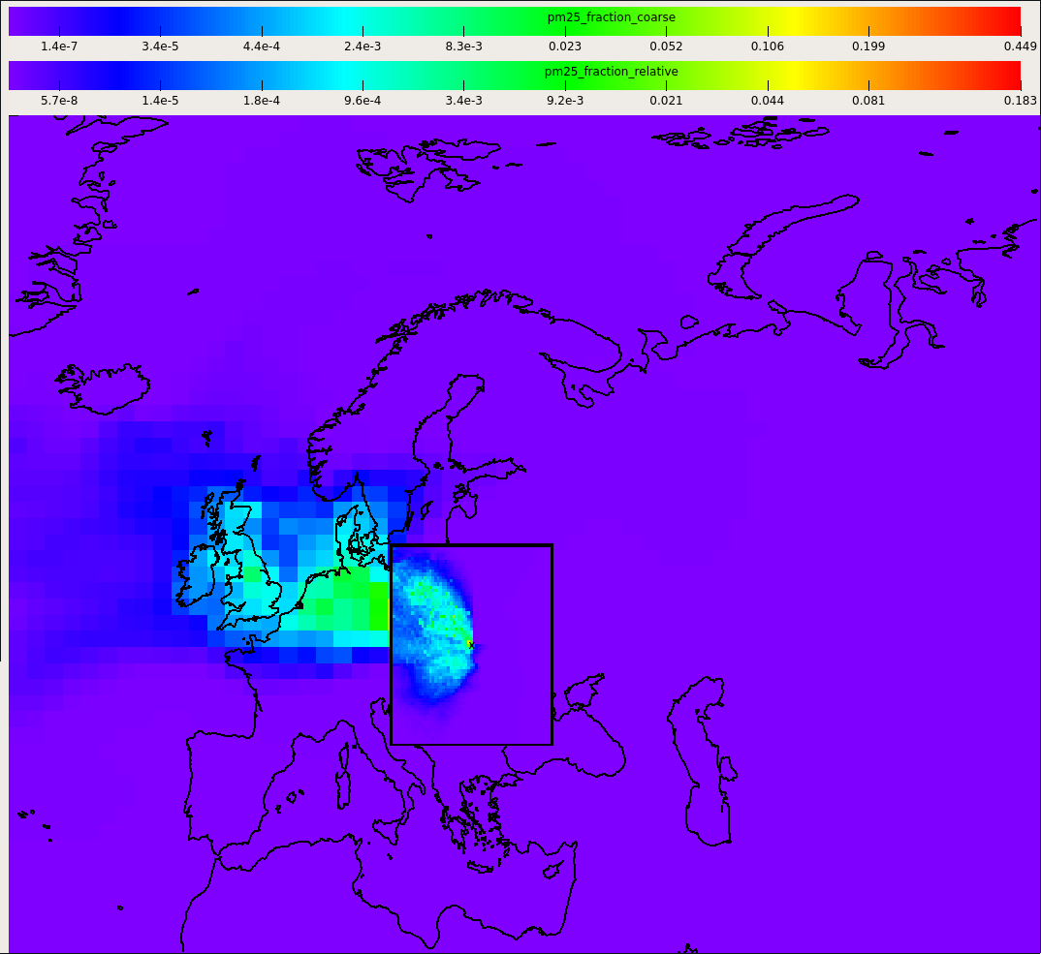
The local fraction methodology
"Local Fractions" implemented in EMEP-MSC-W, provides detailed source map for any point
The basis for the multi-scale/downscaling approach - but generalized to track local fraction to a distance X from a source (not only a few grid cells)
For primary pollutants (+ SOx, and NHx)
Wind, P. et al., Geosci. Model Dev., 13, 1623–1634, 2020
Contributions to point X (3-day run)

Slide 9
How is this useful for GAINS?
Track grid-to-grid in a very CPU-efficient way
Grid-to-grid can (easily) be provided on ‘fine’ resolution (0.1x0.1 degree)
Sectoral grid-to-grid matrices at very low cost
=> Provide grid-to-grid SR for PPM for sectors (and sub sectors)
=> ‘Downscaling’ of new country to grid (0.3x0.2) to 0.1x0.1 degree
Better sectoral representation and better understanding of spatial origin

Slide 10
Recently implemented in GAINS for South Asia
EMEP/MSC-W local fraction tracking of PPM
0.1°, grid to grid, 4 pseudo sectors (vertical emission injection heights)
Used for generating sectoral transfer coefficients, enhanced urban-rural split
Goals:
Better understanding of sectoral contributions to ambient PM_{2.5}
Local vs long range contribution to states and cities
(cost optimal) Strategies for reducing PM_{2.5}

Slide 11
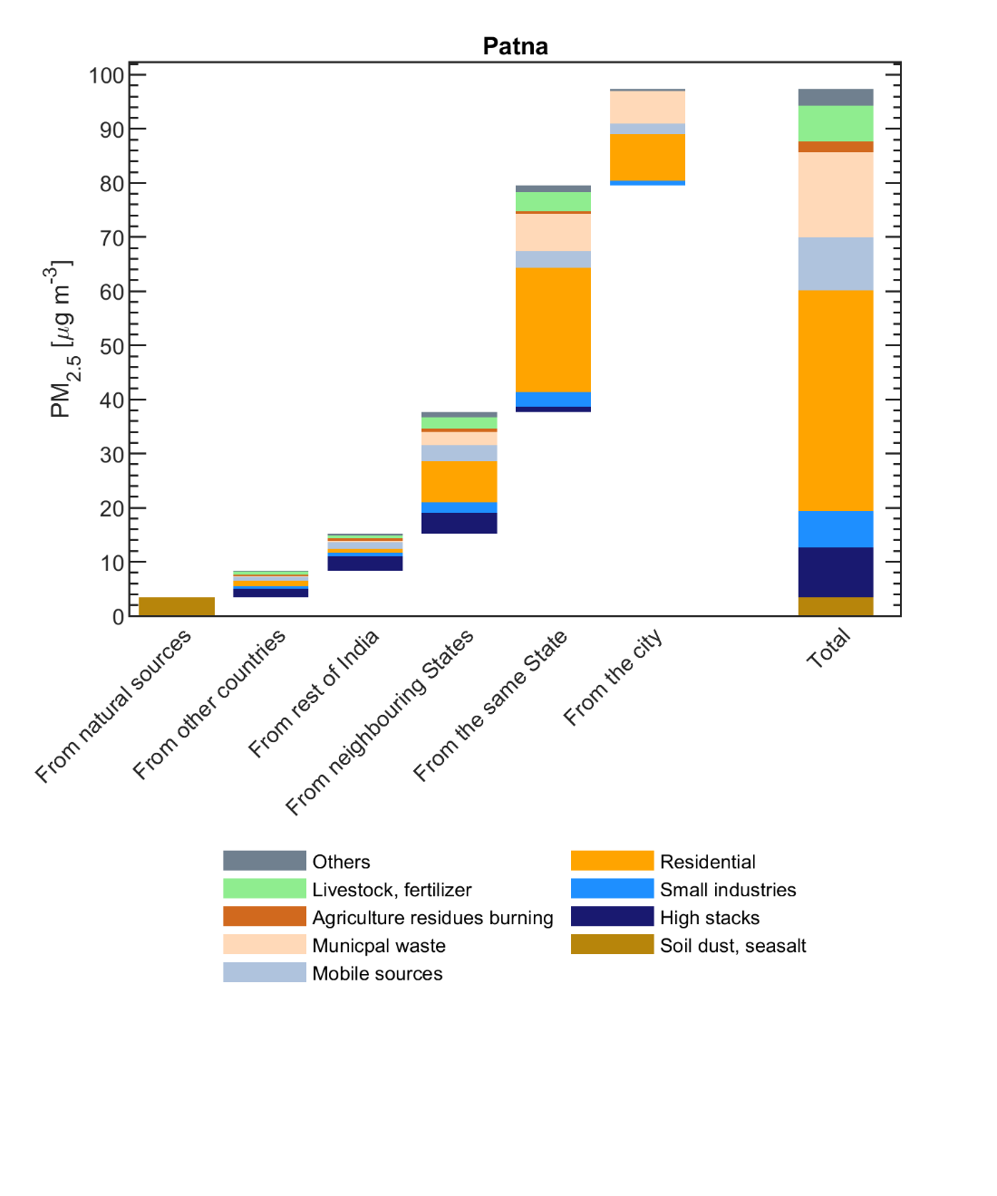
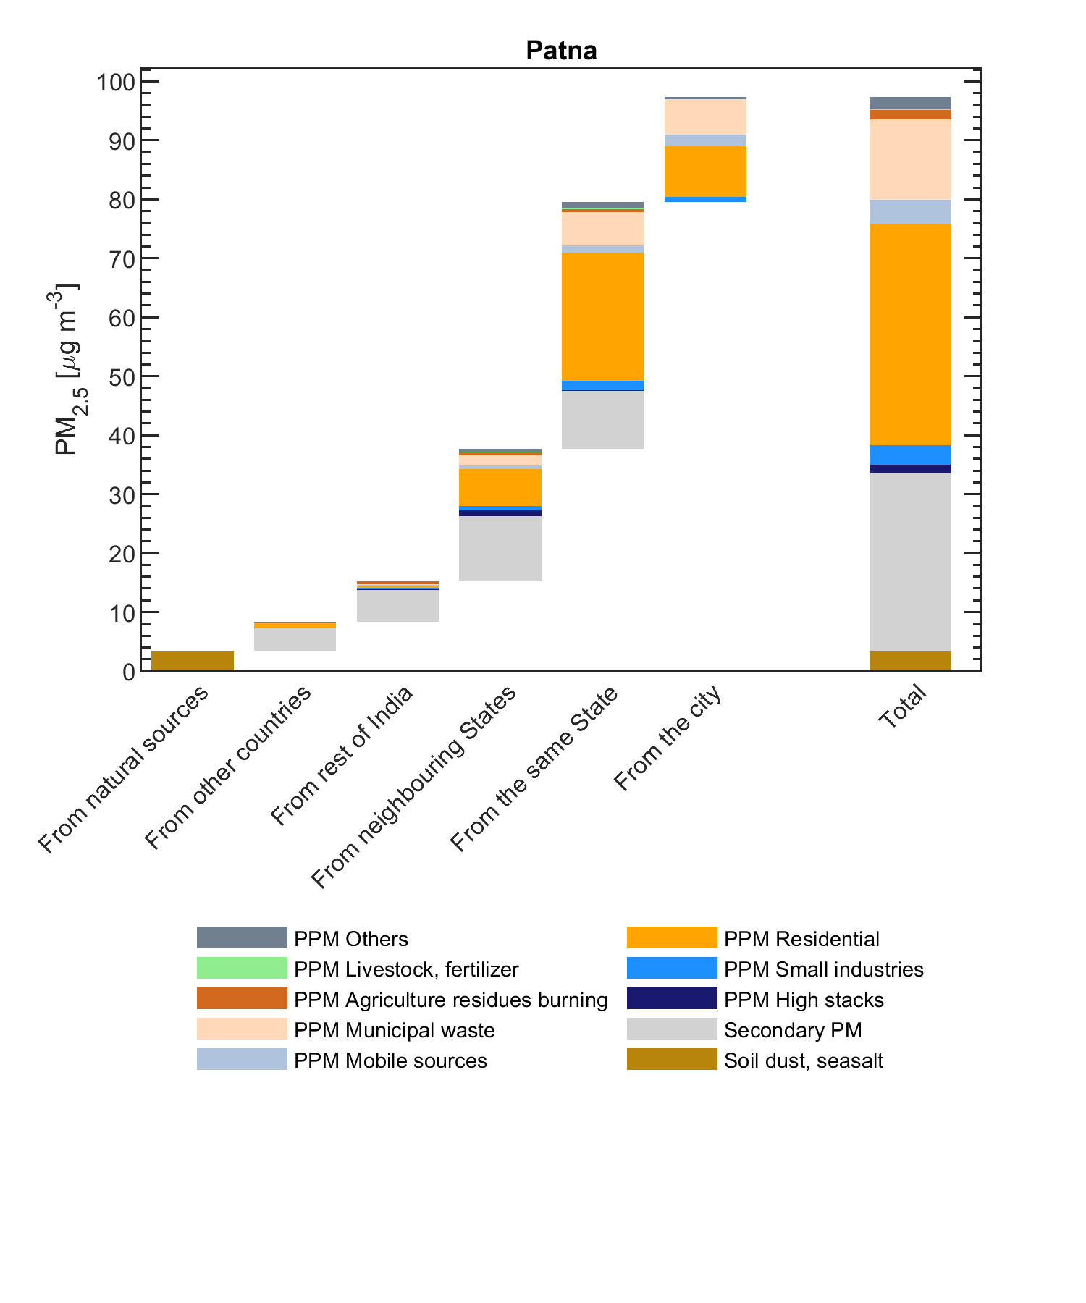
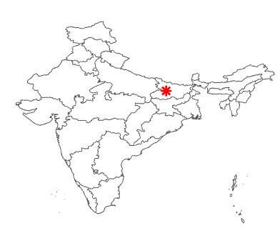
Contributions to city-mean PM_{2.5} in Patna, 2018
All PM_{2.5} precursor emissions
Primary PM_{2.5} vs precursors of secondary PM_{2.5}
Preliminary results!
Courtesy G. Kiesewetter/IIASA

Slide 12
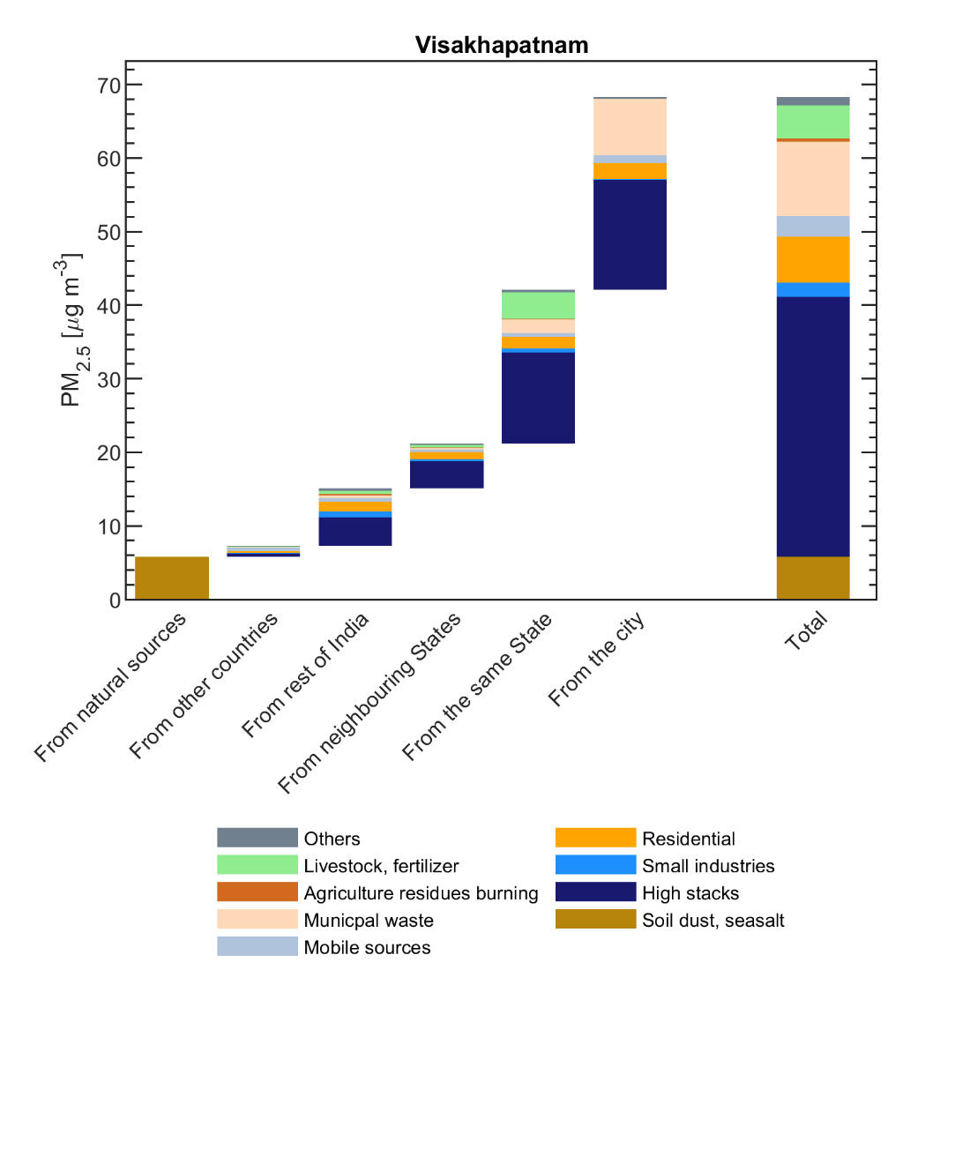
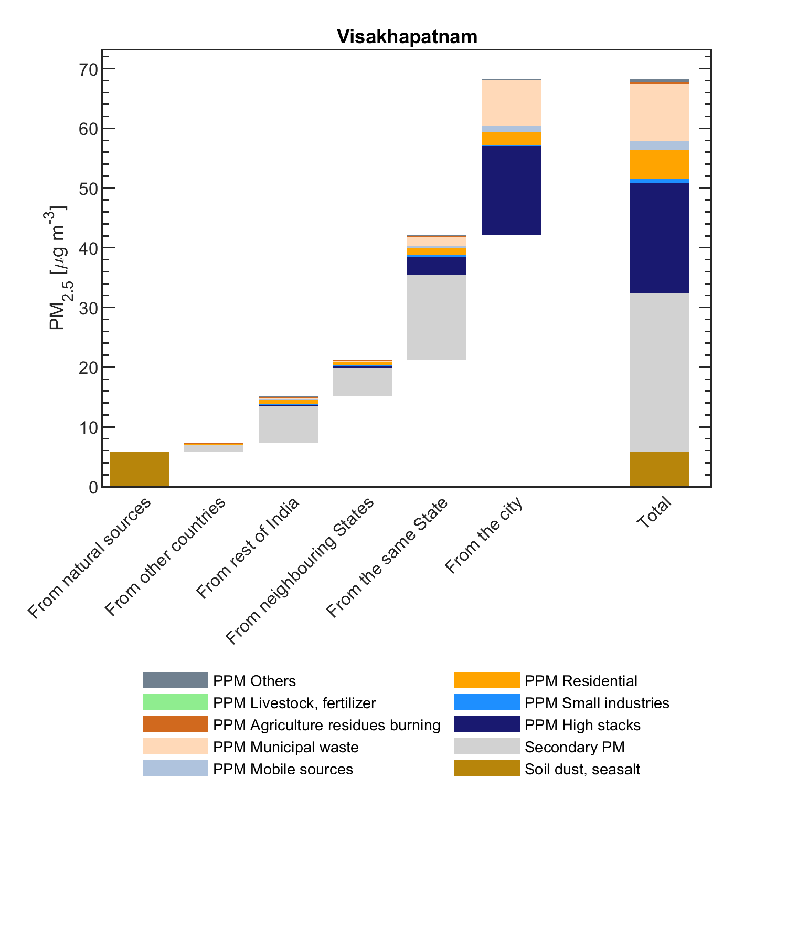
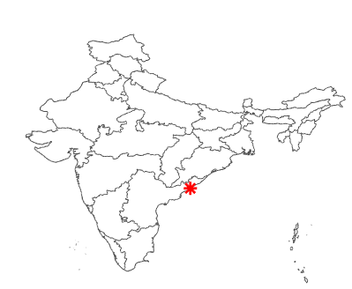
Contributions to city-mean PM_{2.5} in Visakhapatnam, 2018
All PM_{2.5} precursor emissions
Primary PM_{2.5} vs precursors of secondary PM_{2.5}
Preliminary results!
Courtesy G. Kiesewetter/IIASA

Slide 13
How to get to ‘local scale’ in GAINS Europe?
At present some different approximations are possible:
redistribute low level PPM concentrations based 28km->7km->urban polygons (also using population distribution)
Estimate concentrations at monitoring sites using observations to estimate i) road site increment and ii) regional background level (divide urban background into regional background and urban increment). Not used in cost optimization
New approach:
Use uEMEP

Slide 14
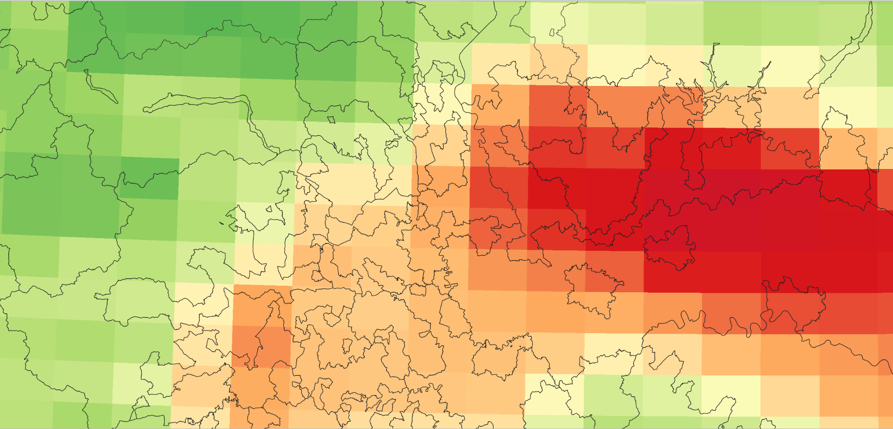
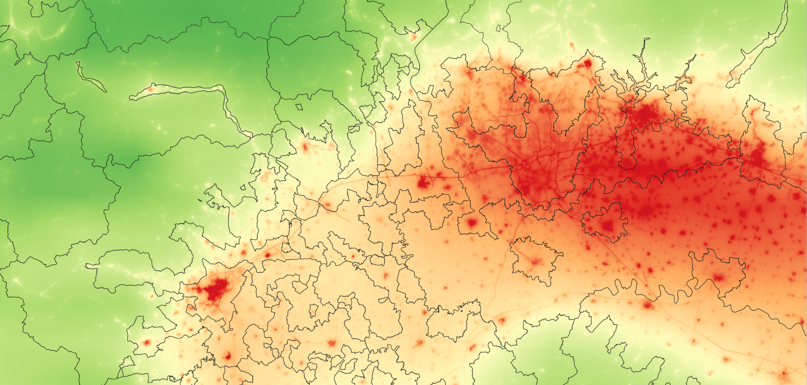
EMEP 0.1º Northern Italy, PM_{2.5}, 2018
uEMEP 250 m Northern Italy, PM_{2.5}, 2018
uEMEP downscaling
uEMEP sub-grid (250 m)
Redistributed sub-grid emissions
Dispersion
uEMEP sub-grid
Non-local
Local
Local
Combine local sub-grid with nonlocal EMEP
Non-local
Non-local
EMEP gridded emissions (15 km)
EMEP grid concentration
Local fraction
EMEP

Slide 15
Implementing uEMEP as part of GAINS
uEMEP provides high resolution (250 m) source contributions of primary pollutants
GAINS will use 0.1 x 0.1º grids to calculate exposure
uEMEP can be used to calculate the sub-grid variability within each EMEP grid in GAINS for a number of sources
This calculation can provide a correction term for GAINS exposure estimates called the ‘Exposure Correction Factor’ (per source/sector)

Slide 16
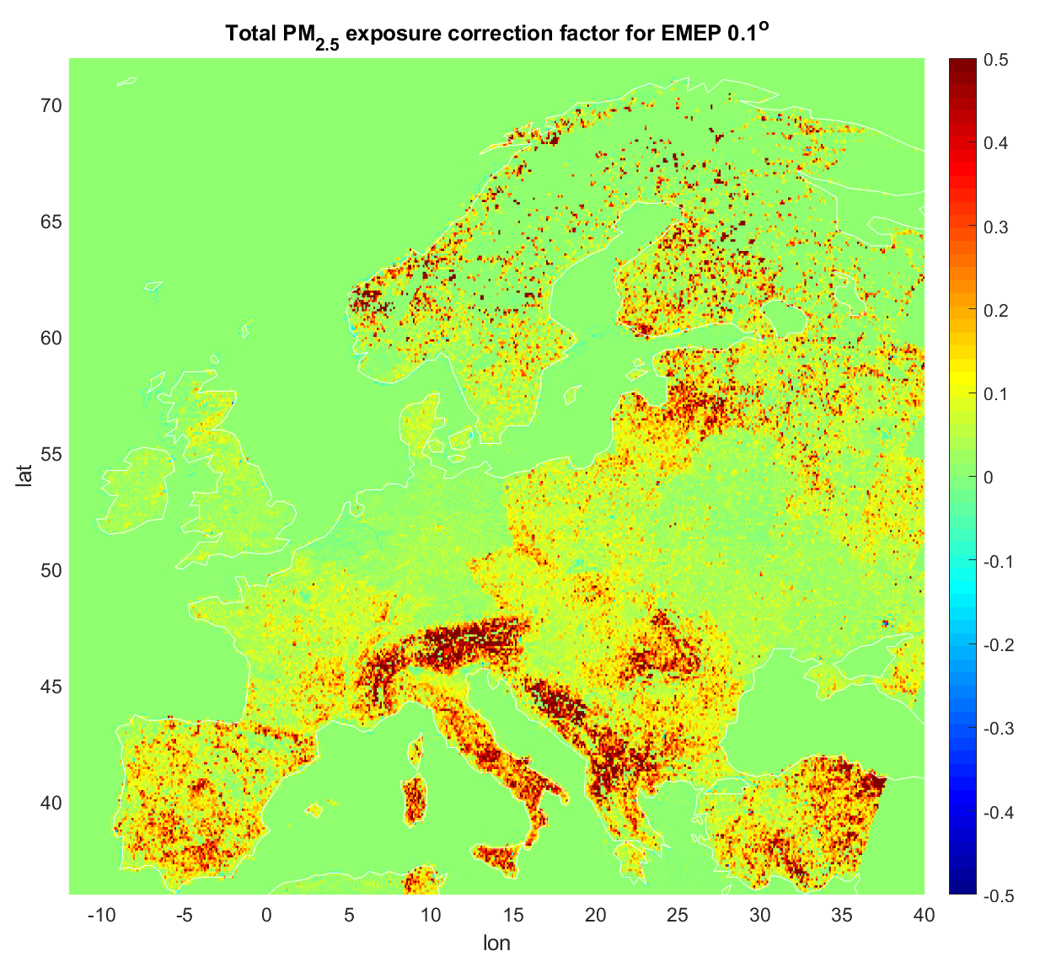
Exposure correction factor for PM_{2.5}
Exposure correction factor for PM_{2.5} for each 0.1 x 0.1º EMEP grid
For EU+EØS this increases the estimated average exposure concentration by 8%
In addition, each EMEP grid will also have an exposure distribution, that will also extend the exposure to higher concentrations (Exceedance distribution correction)
Threshold (𝜇g/m³) | > 5 | > 10 | > 15 | > 20
POP_{uEMEP}/POP_{EMEP}* | 1.006 | 1.16 | 1.54 | 1.41
* Valid for EU+EFTA, population 506 million

Slide 17
Summary
Bridging the scales from regional to local in a updates GAINS:
EMEP/MSC-W country to grid (0.3°x0.2°) based on ‘brute force’ :
5 met years
5 source pollutants (PPM, SO₂, NO_{x}, NH₃, VOC)
=> ca 5x5x50 = 1250 yearly runs
Local fraction tracking (sectoral) of PPM within EMEP (0.1° resolution)
‘Exposure Correction Factor’ and ‘Exceedance distribution correction’ per grid (sector), from uEMEP
Tentative timeline:
Emissions summer 2021
Model simulations fall 2021
Implementation in extended GAINS early 2022
In addition, downscaling model results using emission scenarios from GAINS with uEMEP for testing consistency and answering specific GP review questions will be done

Slide 18
Extra
Numbers for table on exceedance distribution correction:
EU+EFTA EMEP PM2.5
10 ug/m3 = 255 million
15 ug/m3 = 44 million
20 ug/m3 = 17 million
EU+EFTA uEMEP
10 ug/m3 = 296 million
15 ug/m3 = 68 million
20 ug/m3 = 24 million

